Slide 1

Neural Network Perceptron
By: Er. Aarti Sharma
Associate Professor
Department :CSE

Slide 2
Topics Covered:
Introduction to Perceptron
Single Layer Perceptron
Multilayer Perceptron

Slide 3
Neural Networks
Neural networks are made of shorter modules or building blocks, same as atoms in matter and logic gates in electronic circuits. Once we know what the blocks are, we can combine them to solve a variety of problems.
Processing of Artificial neural network depends upon the given three building blocks:
Network Topology
Adjustments of weights or learning
Activation functions

Slide 4
Types of Neural Network
Neural Network types can be classified based on following attributes:
Connection Type
Static (Feedforward)
Dynamic (Feedback)
Topology
Single Layer
Multi Layer
Recurrent
Learning Methods
Supervied
Unsupervied
Reinforcement

Slide 5
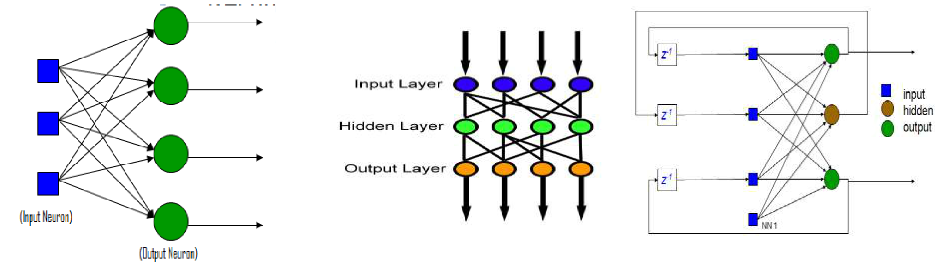
Classification Based on Connection Type
Static (Feed forward)
Dynamic (Feedback)
Classification Based on Topology
Single Layer Multilayer Recurrent

Slide 6
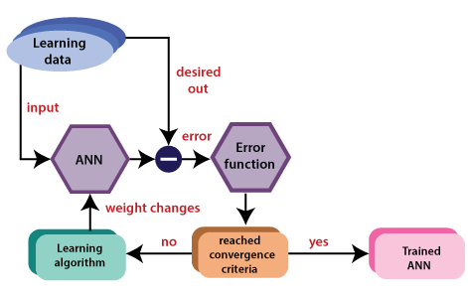
Classification Based on Learning Algorithms
a) Supervised Learning
In it network is trained by providing it with input and match the output patterns.
Input output pairs can be
provided by external learning data.
(self-supervided)system.
An error signal is produced if there is a difference between the actual output and the desired output vector.
Based on this error signal, the weight is adjusted until the actual output is matched with the desired output.

Slide 7
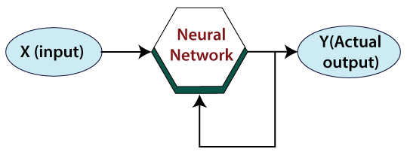
b) Unsupervised Learning
No help from outside
No training data, no information available on the desired output.
Learning by doing.
Used to pick out the structure in the input from clustering.
Eg. Kohonen’s Learning Law

Slide 8
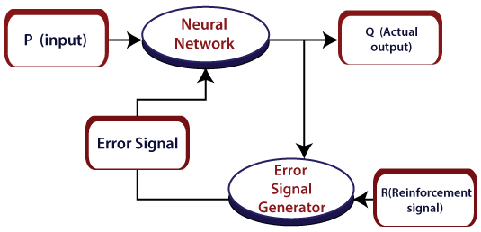
c) Reinforcement Learning
It is a technique that helps to solve control optimization issues.
Its existence comes when the system has a huge number of states and has a complex stochastic structure, which is not responsible to closed-form analysis.
If issues have a relatively small number of states, then the random structure is relatively simple, so that we can utilize dynamic programming.
By using control optimization, we can recognize the best action in each state visited by the system in order to optimize some objective function.

Slide 9
THANK YOU!

